Slide 1



Slide 1
- Financial PowerPoint Presentation -

Slide 2



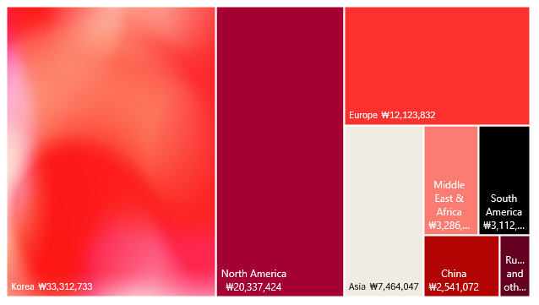
Revenue per Region
Regional Revenue in 2023
Asia accounted for roughly 50% of LG’s revenue during the 2023 fiscal year. Growth in Korea was able to offset the 5% in loses in the rest of Asia. Conflict in Russia also saw a 25% decrease in revenue from the region.
Korea
40%
North America
25%
Europe
15%
Asia
9%

Slide 3
Product revenue
Camera module and others.
Steady 5% growth in revenue compared to previous fiscal year.
25%
35%
Refrigerator/ washing machine/ air conditioner and others.
Largest source of revenue, however, stagnant growth from 2022-2023
In-vehicle infotainment and others. Saw the largest growth from 2022 with a 17% increase in revenue from the previous fiscal year.
12%
17%
TV/AV and others.
Decrease in revenue of roughly 10% since 2022

Slide 4



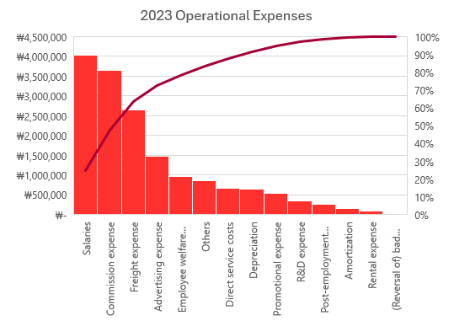
Operational Expenses
Employees salaries and benefits account for 55% of total general operating expenses
Post-employment benefits reduced by 35% compared to 2022
Freight expenses saw a reduction of 33% likely due to supply chain corrections post covid
The company saw a 17% rise in promotional expenses and 3% among advertising expenses, however, revenues saw a 1% throughout the company

Slide 5
A Tale of Taxes
-26%
35%
-43%
Profit before Taxes
Increase in Taxes
Profit after Taxes
Profit decreased by 26% from 2022 to 2023 due to increase in administrative costs and a decrease non-operative income because of exchange differences.
Despite the decrease in revenues the company taxes amount to 35% more being paid out relative to the previous year. The company’s effective tax rate was 38.5% compared to the previous year’s 20.7%.
The decrease in revenue combined with the increased tax burden let to a drop in profit amounting to 43% compared to the previous year.

Slide 6
Summary
Revenue
Expenses
Taxes
$704.78
Growth in North America is promising with in-vehicle infotainment leading the way. The acquisition of LG Display Co., Ltd. is contributing to that growth.
The decreased revenue in Russia should be expected to return when conflict in the region is resolved.
Despite increases in promotional expenses and advertising costs, the company’s revenue saw minimal growth of 1%. This was led by a 10% decrease in sales from the Monitor/PC sector and an 11% in the TV/AV sector. This may indicate the advertising dollars are being used inefficiently to sell LG’s current lineup of products.
Taxes played a large role in the company’s decrease in profits during 2023. The increased tax burden of 38.5% led to decreased profits of 43% compared to 2022’s profit after taxes. Increased expenditure into the business may be a better use of funds to circumvent future tax expenditures.
$191.01
$189.31
$186.54

Slide 7




Slide 10

